Slide 1
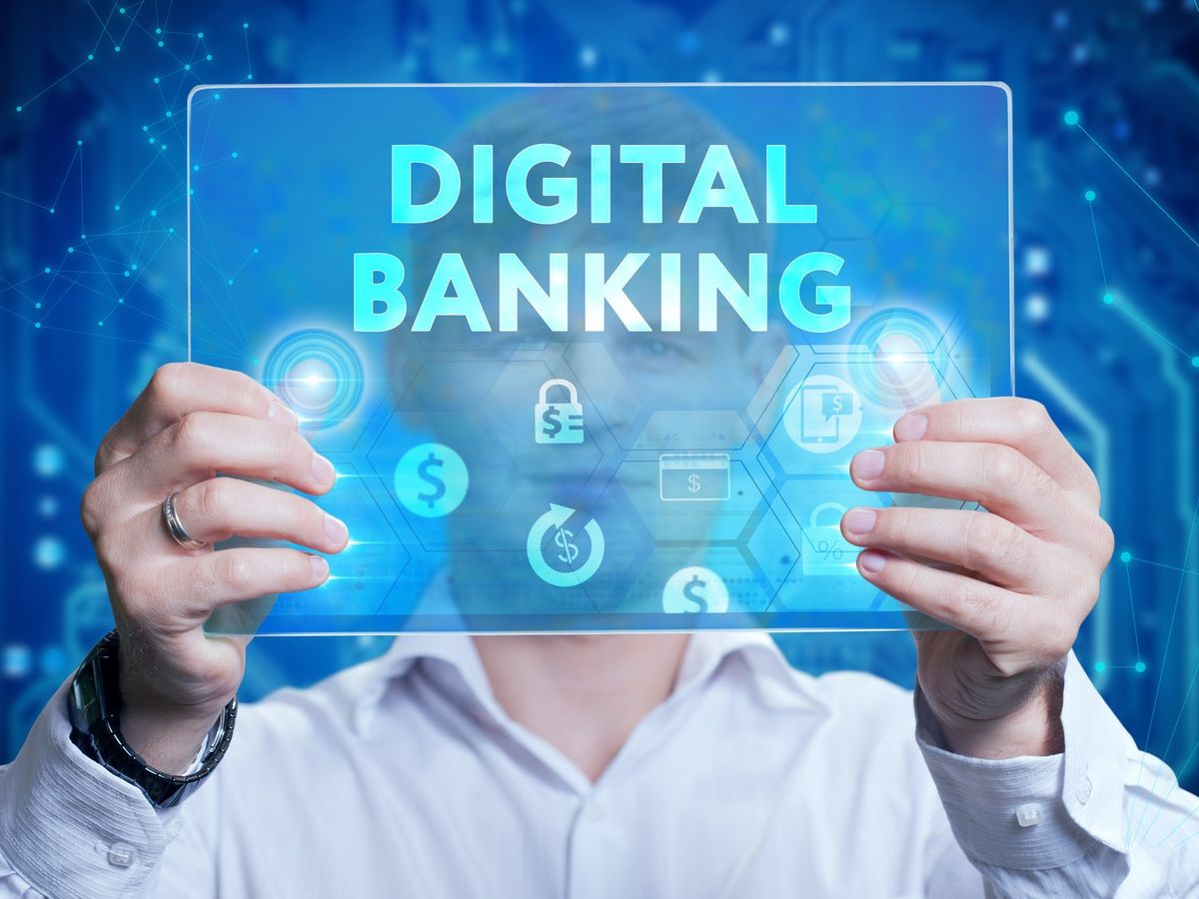
Author :Bhushan Sakhalkar

Slide 2
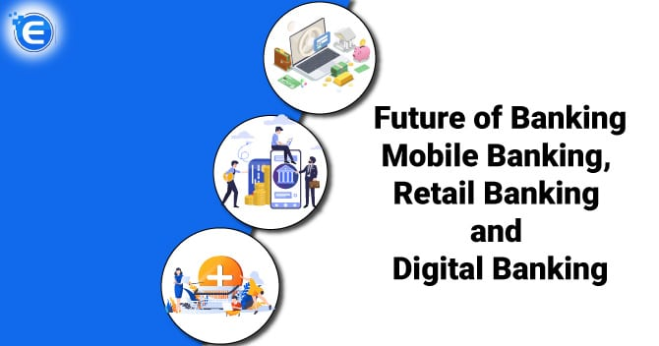

Slide 3
ABSTRACT
Digital banking digitizes all traditional banking activities, allowing customers to manage accounts, transfer funds, pay bills, and invest via online platforms and mobile apps without visiting a branch. It offers 24/7 access, enhanced efficiency, and advanced security, including biometrics and real-time alerts. Digital banking is a structured MySQL Workbench project of some customers and there details of accounts, transactions, cards and loans. Through queries, joins, subqueries and views the data enables that we have to move towards new generation of digital banking. Using a snowflake schema, it supports efficient data analysis and smarter decision-making. This project showcases database design and advanced SQL skills for real-world banking applications.

Slide 4
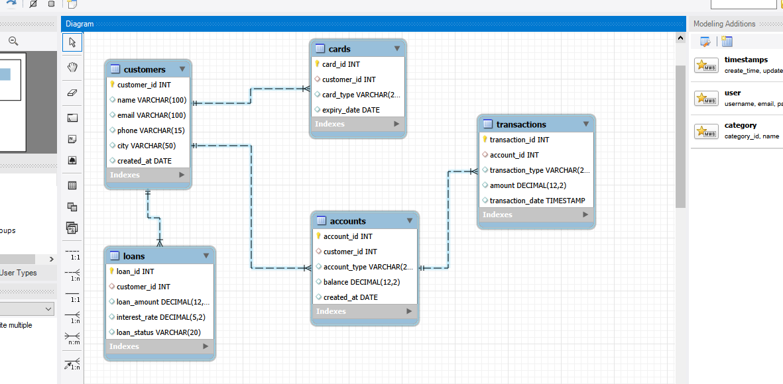
EER Diagram

Slide 5
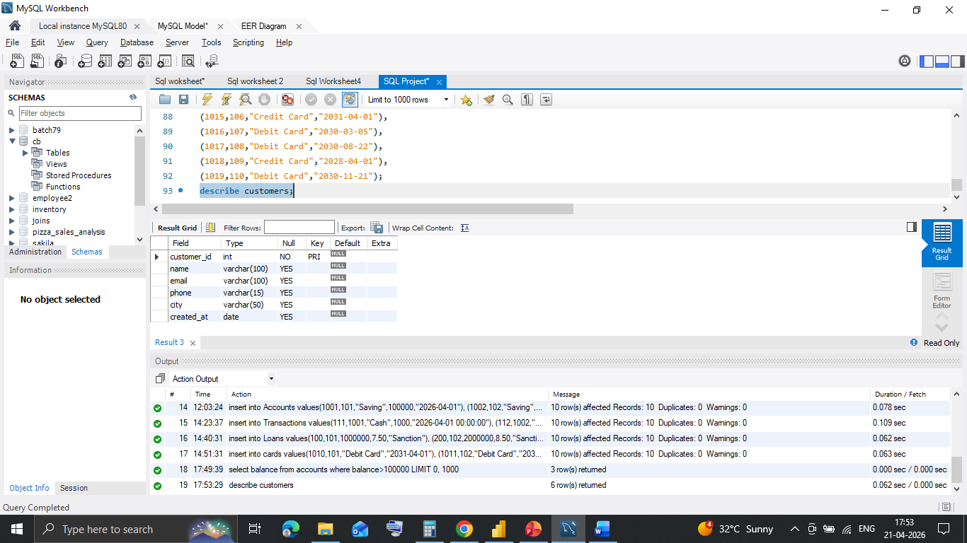
Schema for customer table

Slide 6
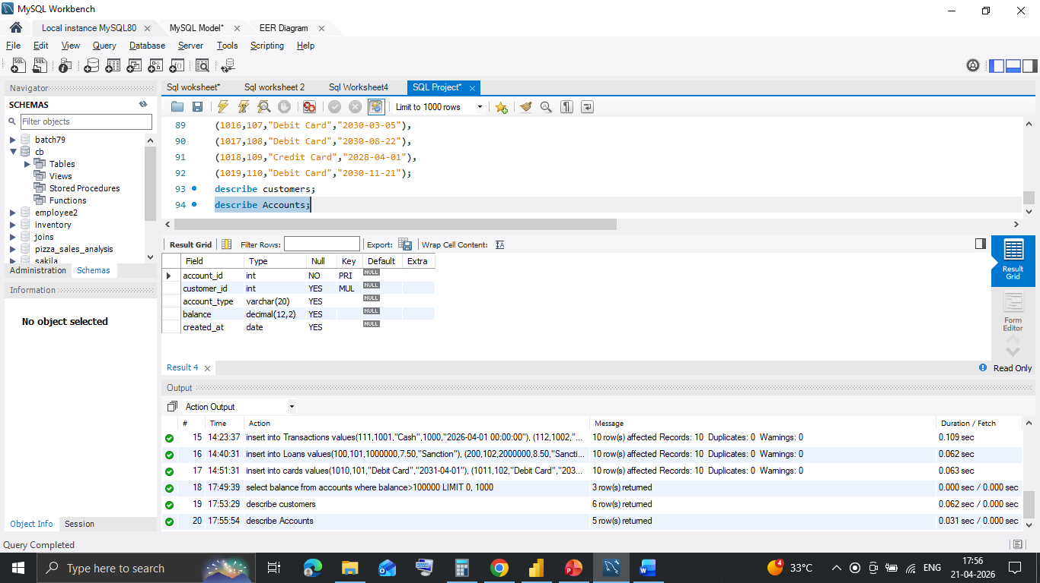
Schema for Accounts table

Slide 7
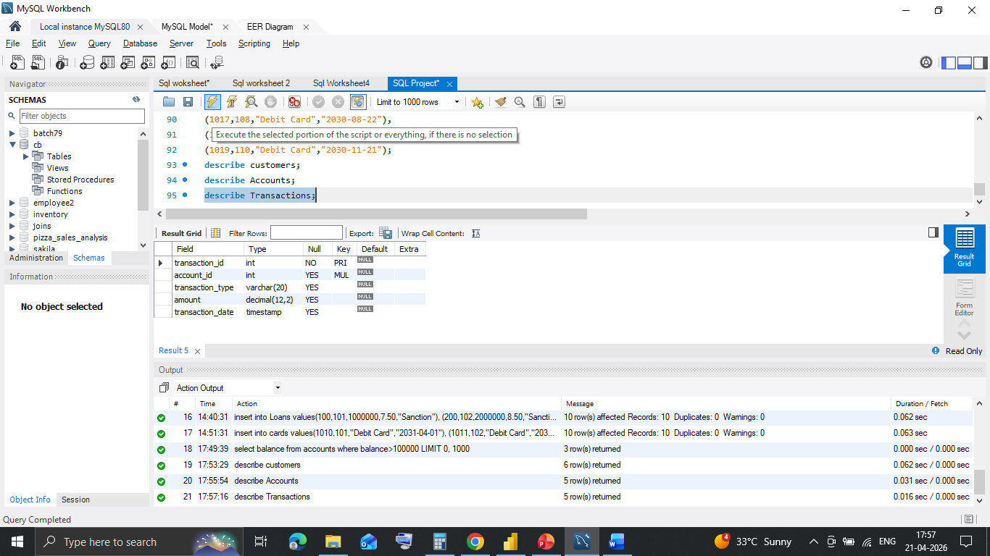
Schema for Transactions table

Slide 8
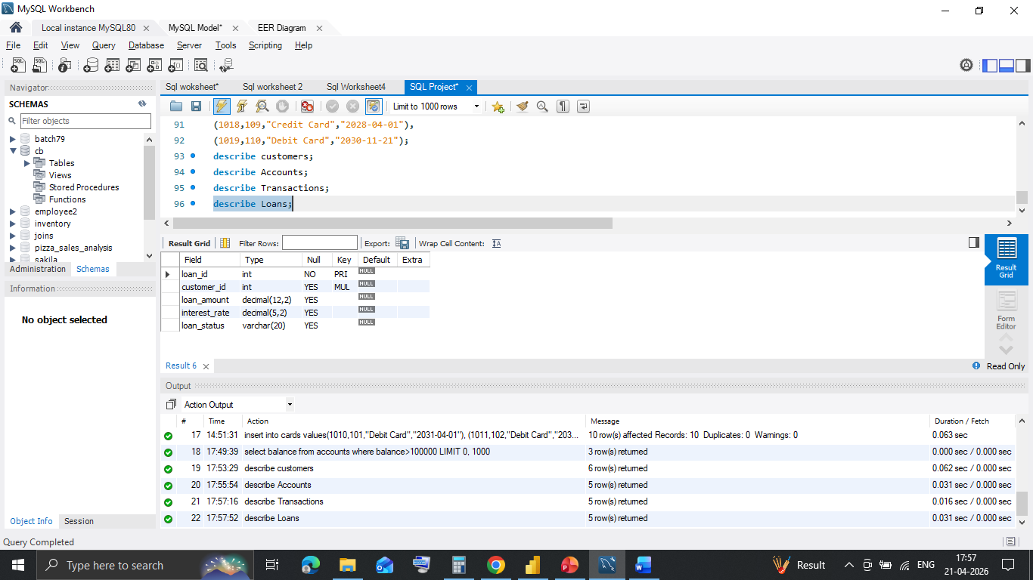
Schema for Loans table

Slide 9
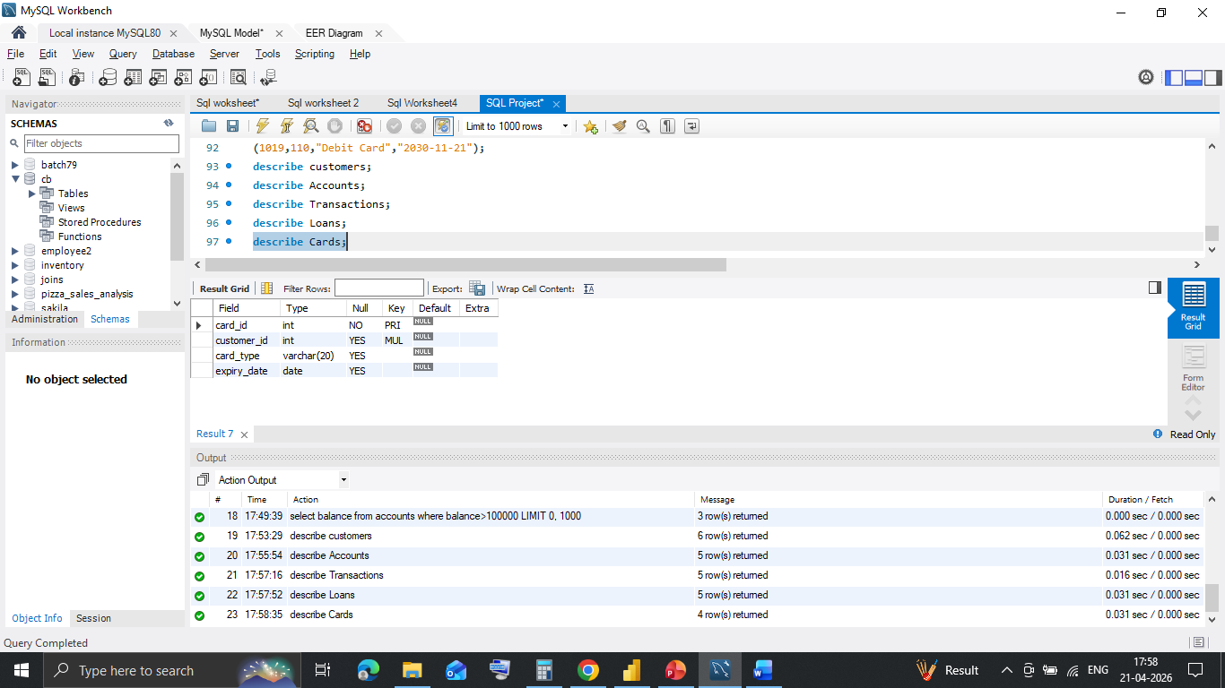
Schema for cards table

Slide 10
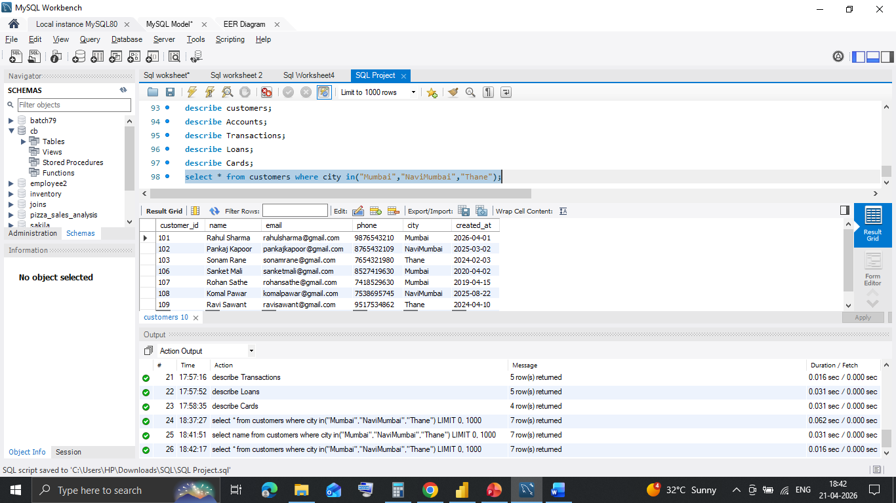
Customer base calculation Following select * from customers query is used for customer base. Result : It will help to know customer base for marketing.

Slide 11
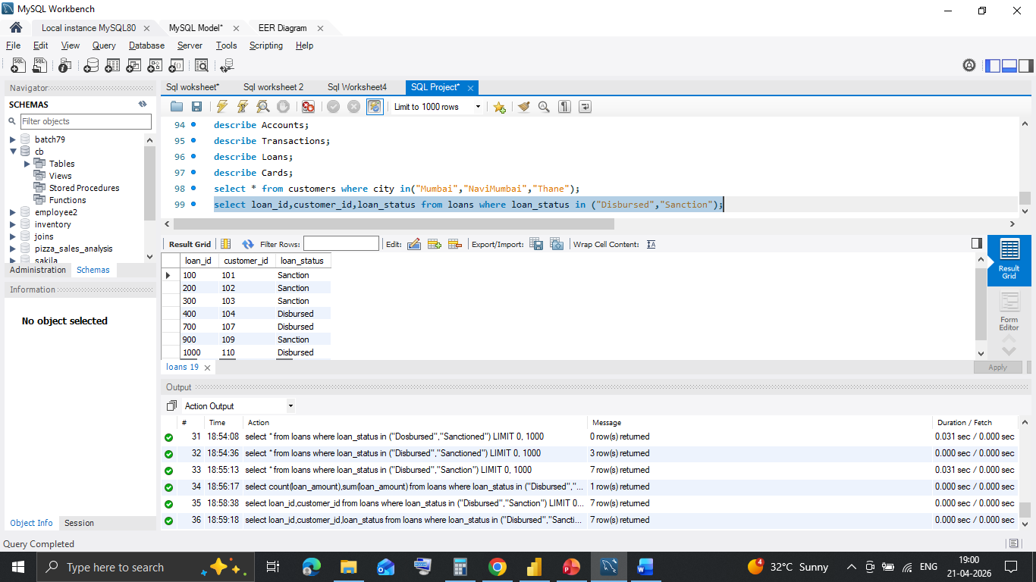
Loan status Following select query with where condition and in is use for loan status Result : It helps to know pending for disbursement

Slide 12
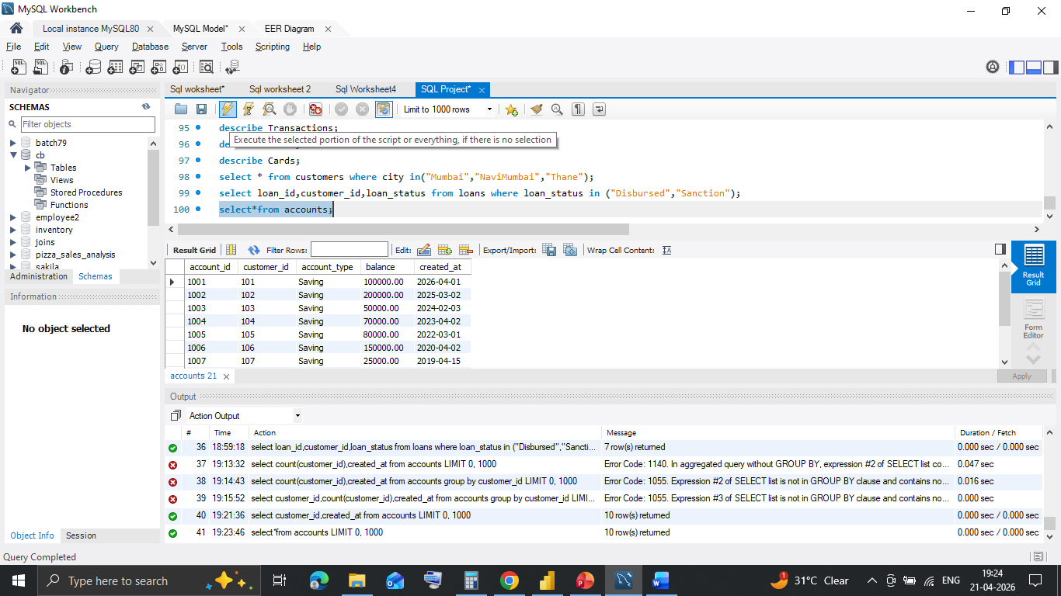
Account open status Following select * from accounts query is use for account open status Result : It helps to know how many accounts open with balance on date

Slide 13
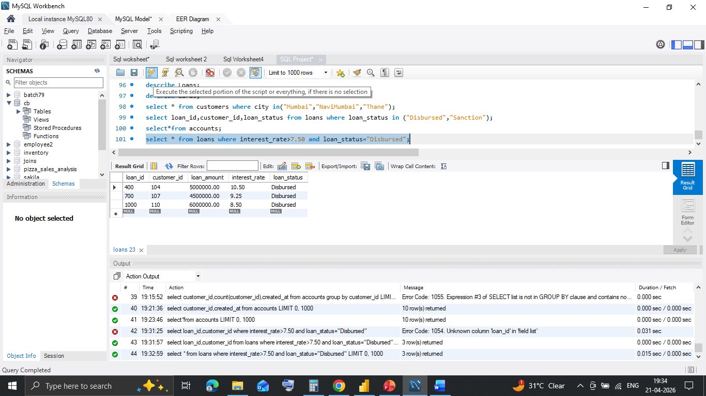
Loans with high interest Following select query is use with where condition and greater than for loans with high rate. Result : It helps to know how many loans disbursed with high rate which generate high return.

Slide 14
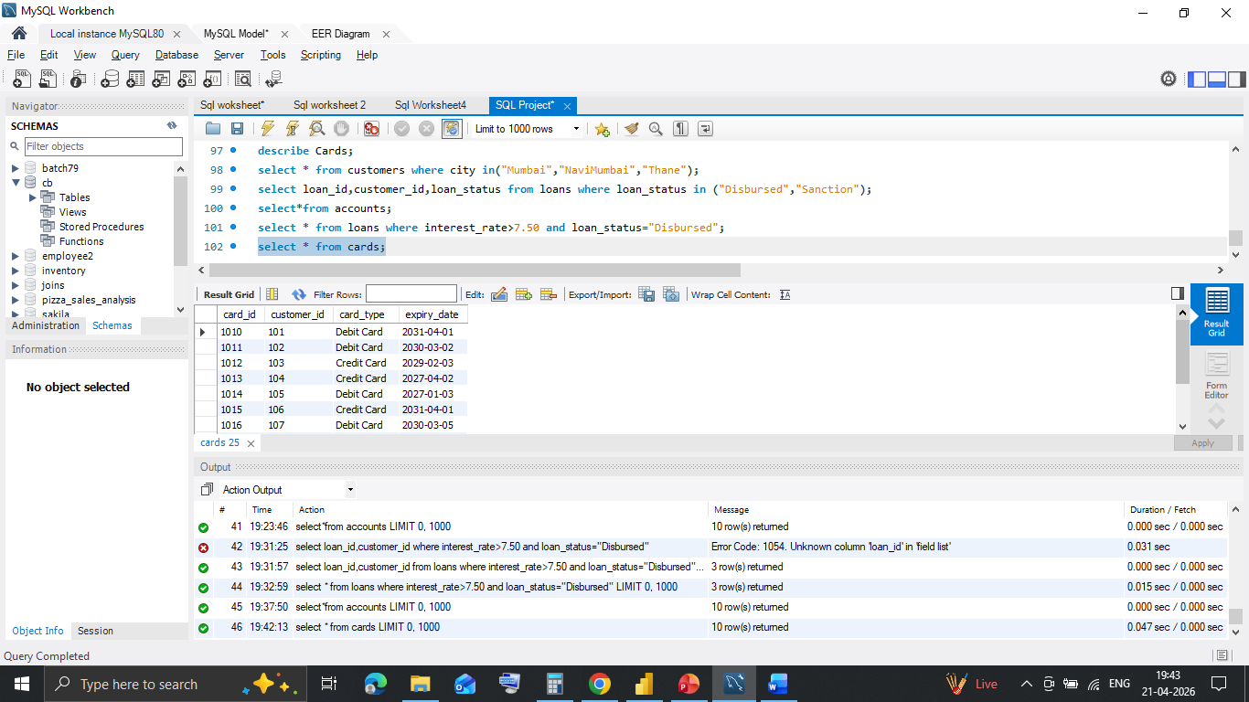
Debit, Credit card status Following select * from cards query is use for debit and credit card holders Result : It helps to contact debit card holders for credit card

Slide 15
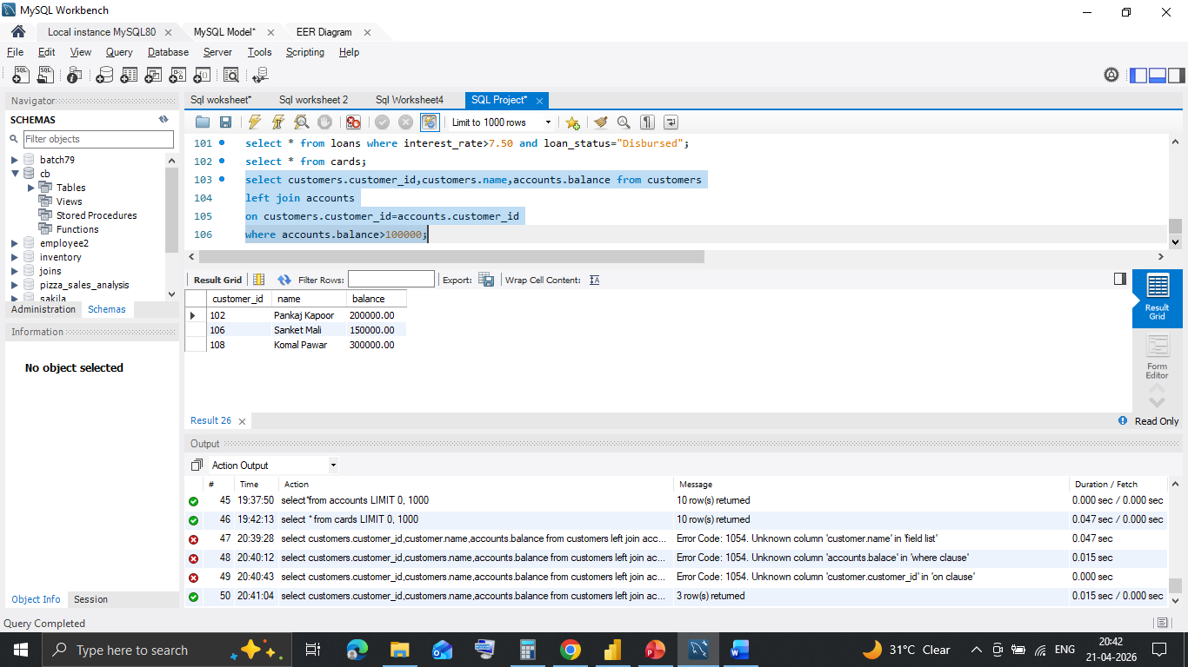
Account Balance Following left join query is use for accounts with big balance Result : It helps to know HNI(High Net-Worth Individual) for best service

Slide 16
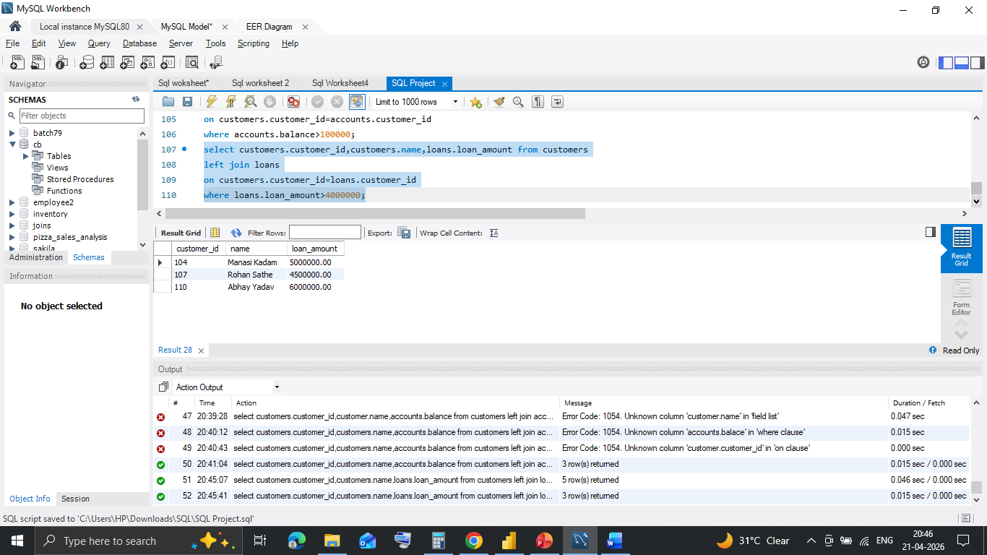
Loan Amounts Following left join query is use for loans with big disbursement. Result : It helps to know for more business in future

Slide 17
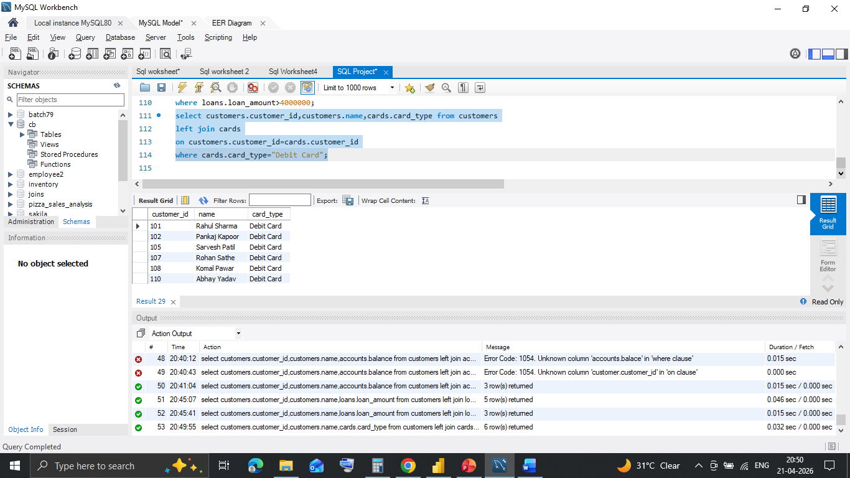
Debit card status Following left join query is use for debit card holders. Result : It helps to know of debit card holders for future reference.

Slide 18
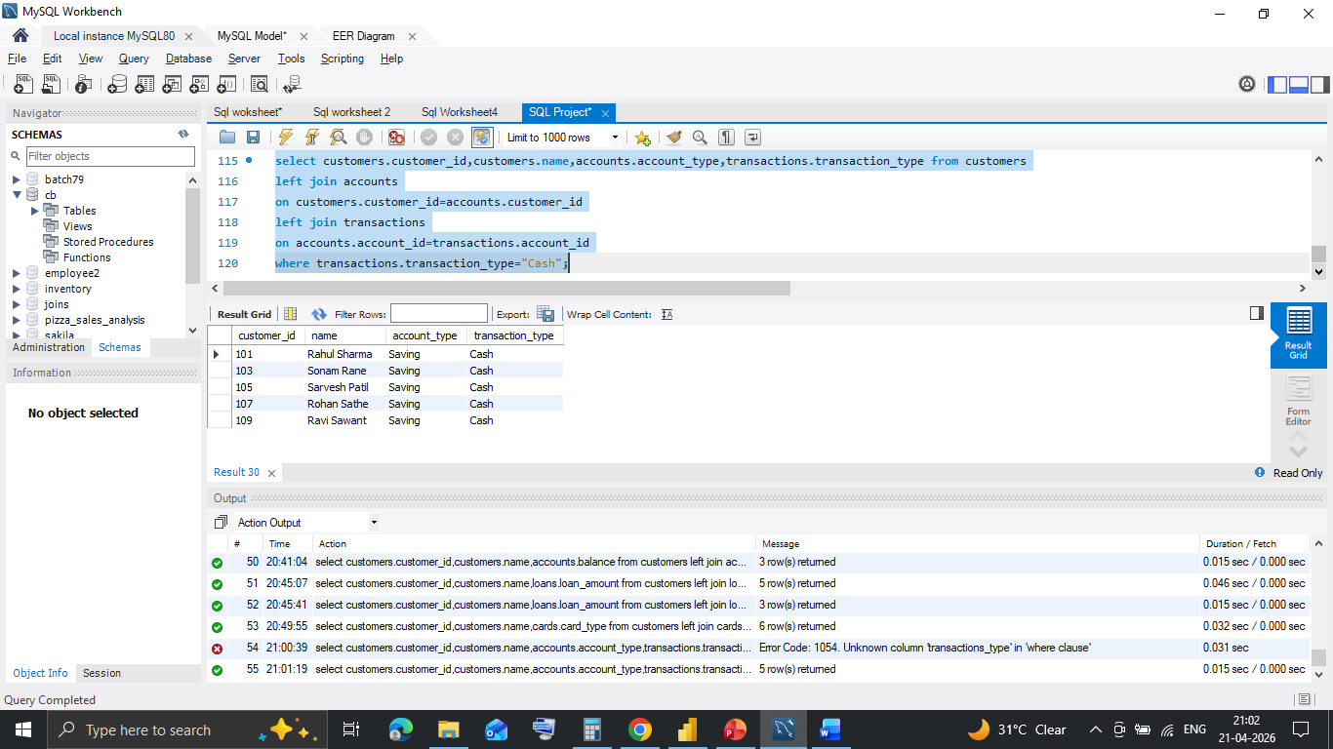
Transaction status Following left join query is use for cash transaction. Result : It helps to know convincing for digital transaction

Slide 19
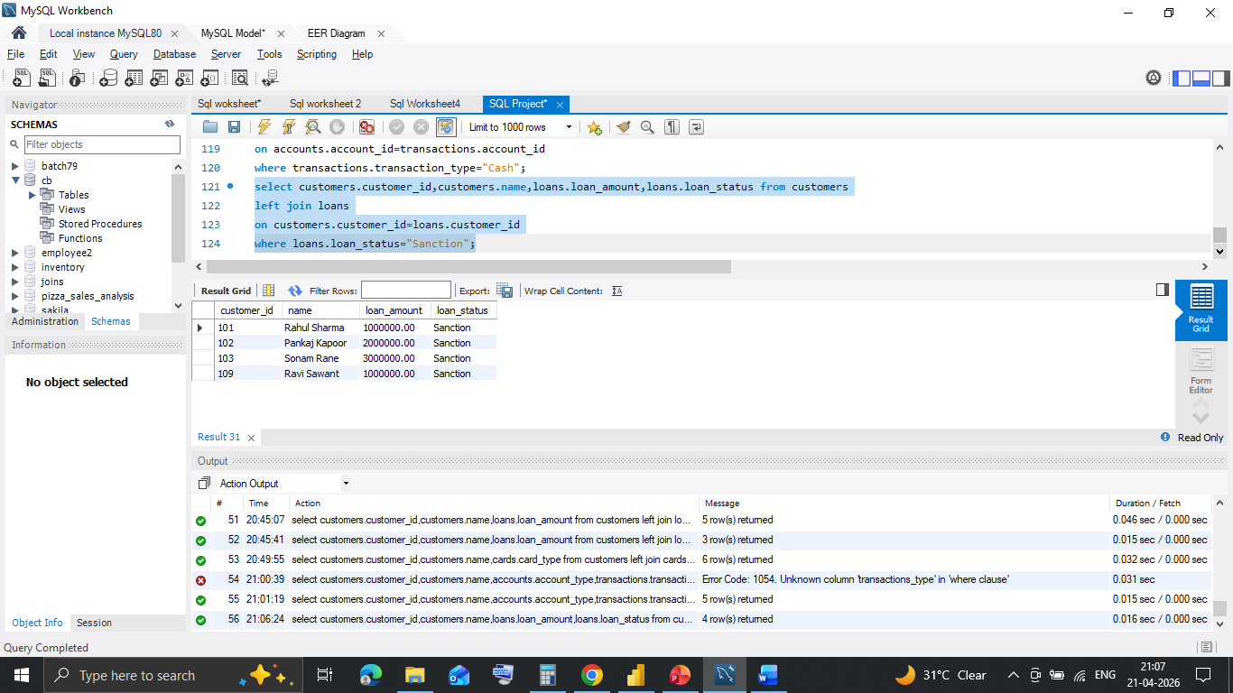
Sanction status Following left join query is use for sanction status. Result : It helps to know to convert sanction to disburse.

Slide 20
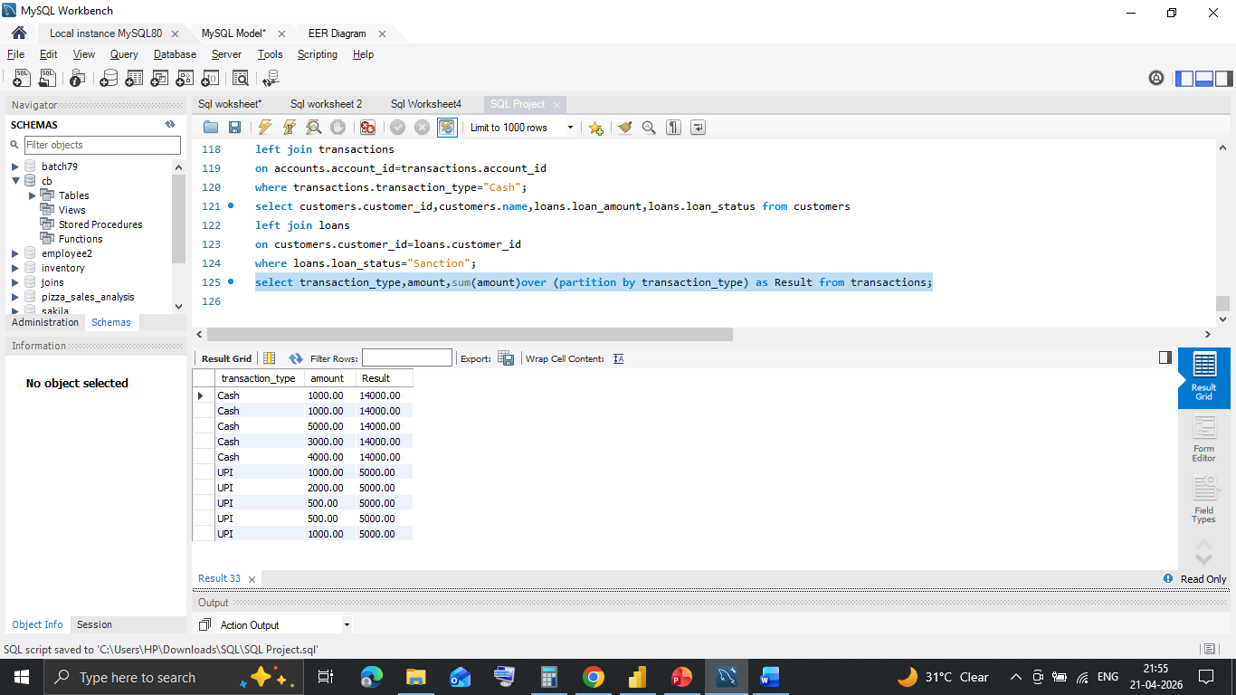
UPI status Following Windows sum query with partition by is use for upi status. Result : It helps to know running total of upi and cash transaction to convert cash to upi.

Slide 21
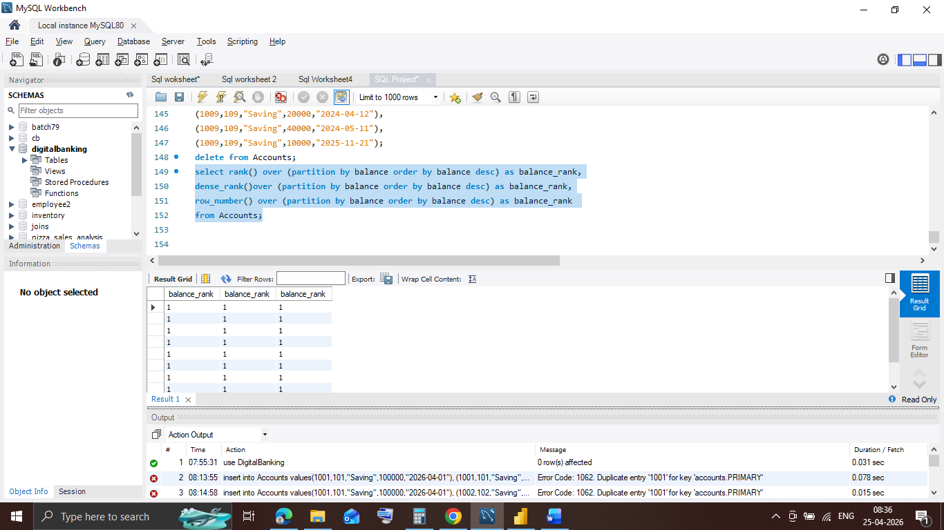
HIGH balance status Following Windows rank query with partition by is use for balance status. Result : It helps to know highest balance among all account but result shows 1 as only one transaction entry per account.

Slide 22
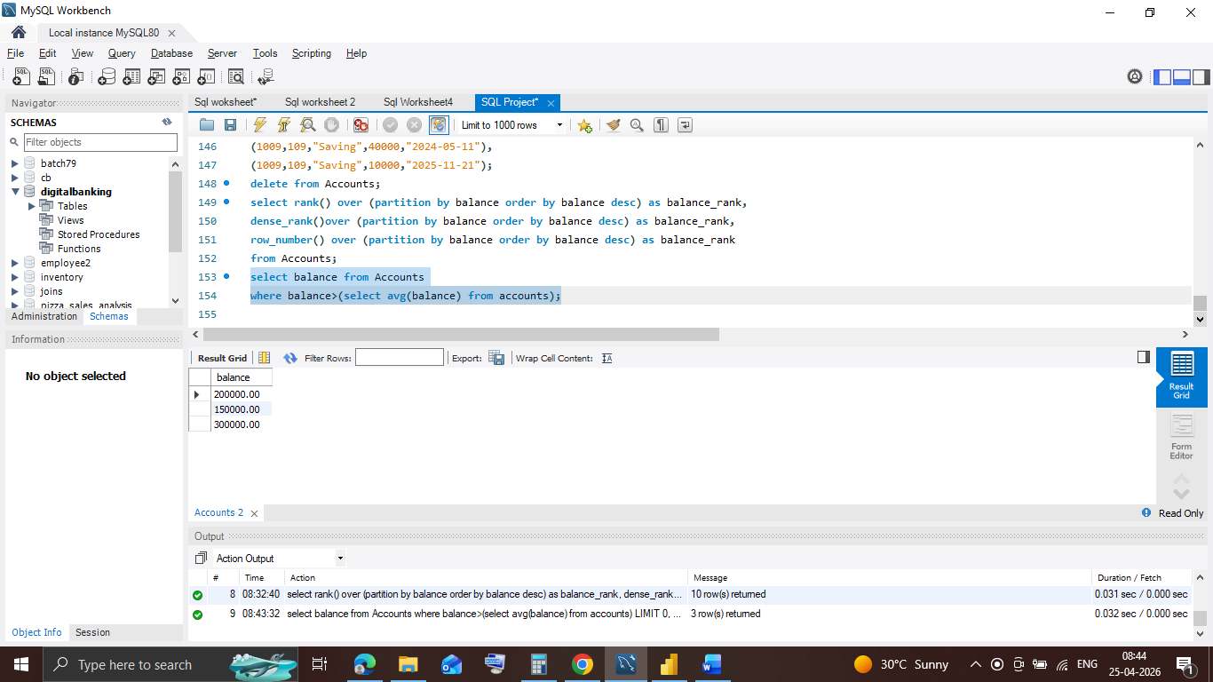
Average balance status Following Multirow subquery is use for average balance. Result : It helps to know accounts maintaining high balance than average balance.

Slide 23
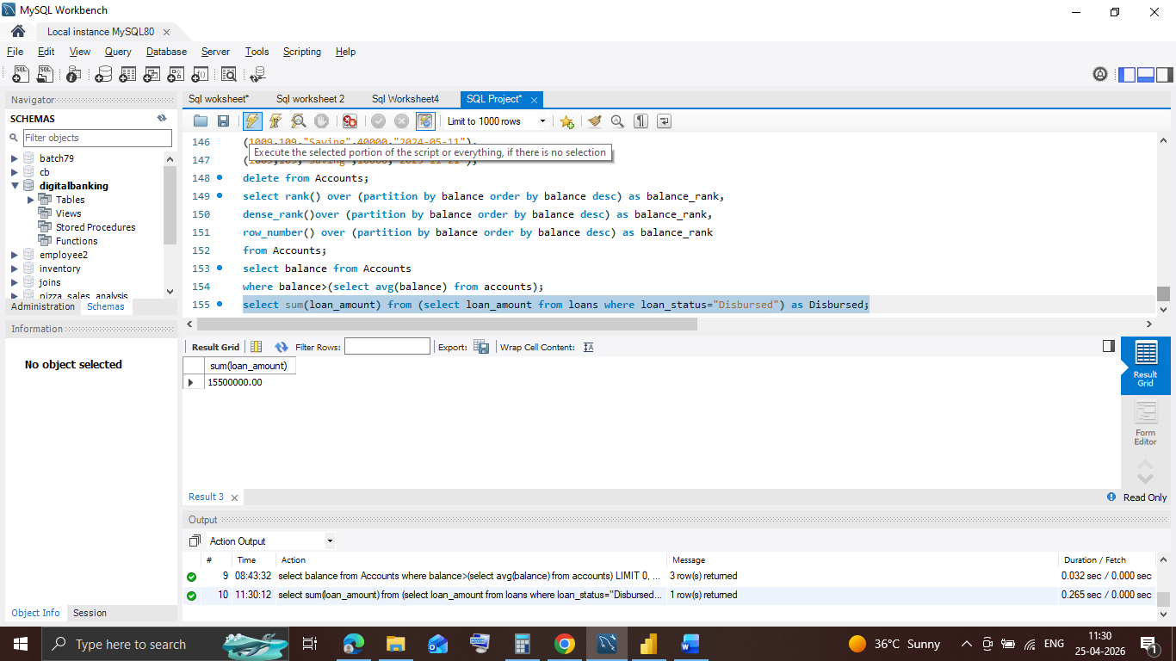
Disbursed data Following scalar or single row subquery is use for disburse amount. Result : It helps to know amount of disbursement.

Slide 24
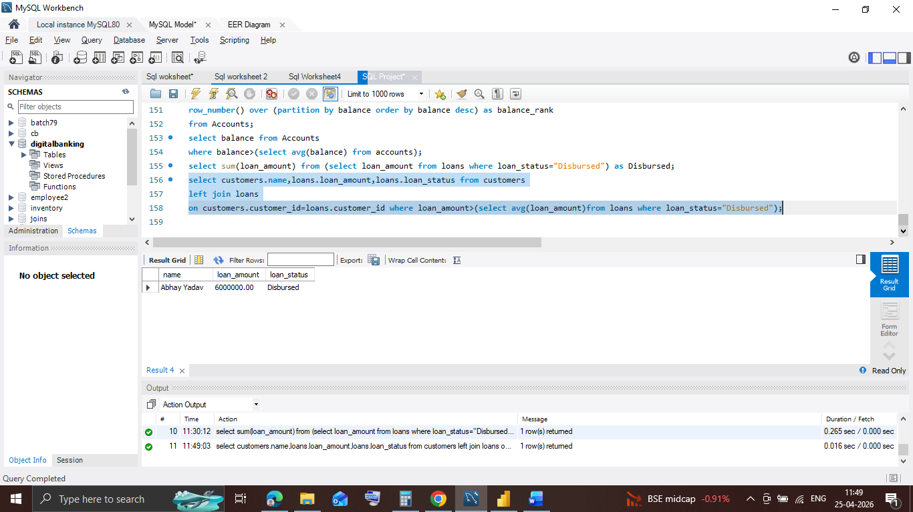
Average Disbursement Following correlated subquery is use for average disburse amount. Result : It helps to know customers who’s disbursement is more thane average.

Slide 25
Conclusion
The project highlights the vital role of SQL in banking system.
It starts with an overview of digital banking importance, then explores key SQL concepts in detail.
Joins, subqueries, and queries are used extensively to improve disbursements, convert cash to upi, marketing for more loans and deposits and enhance reporting capabilities.
Practical case studies demonstrate how these SQL techniques help to increase digital banking , cut costs, and boost operational efficiency in banking industry.
Digital banking provides customers with 24/7 access to services from anywhere, offering superior convenience, speed, and security over traditional banking
The project emphasizes that a well-designed system using advanced SQL techniques is crucial for data-driven decision-making and successful digital banking.

Slide 26


